Slide 1
Learning Management System
A Comprehensive Look at LMS Implementation

Slide 2
Introduction
This presentation explores the concept, benefits, and core features of Learning Management Systems (LMS) and how to implement them effectively.

Slide 3
01
Overview

Slide 4
Definition of Learning Management System
A Learning Management System (LMS) is a software application designed to facilitate the administration, documentation, tracking, reporting, and delivery of educational courses or training programs. It provides a centralized platform for both educators and learners to manage the learning process efficiently.

Slide 5
Scope of System
The Learning Management System (LMS) will store and manage all academic and personal details of the students enrolled in the platform. It will also maintain records of the courses offered, assignments, and assessments. The system will allow for easy updates, modifications, and deletion of student and course details to ensure that the information remains accurate and up to date.

Slide 6
Purpose and Benefits
LMS aims to enhance the learning experience by streamlining the process of creating, delivering, and tracking learning programs. Key benefits include improved accessibility for learners, data analytics for performance tracking, enhanced engagement through interactive content, and reduced training costs for organizations.

Slide 7
Key Features
Key features of an LMS include user management, course management, assessment tools, reporting and analytics, and integration capabilities with other systems. User management allows for easy enrollment, tracking of progress, and role assignments. Course management facilitates the creation and organization of learning materials. Assessment tools enable quizzes and certification processes. Reporting and analytics provide insights into learner performance and engagement. Integration capabilities ensure that the LMS can work alongside existing tools or systems.

Slide 8
02
Implementation

Slide 9
Planning and Requirements
Effective LMS implementation begins with detailed planning and understanding the organization's training needs. This includes defining the target audience, identifying the specific learning objectives, and assessing the resources available. Gathering requirements from stakeholders helps to customize the LMS to fit their needs. Budgeting for software, potential customization, and training costs is essential to ensure seamless deployment.

Slide 10
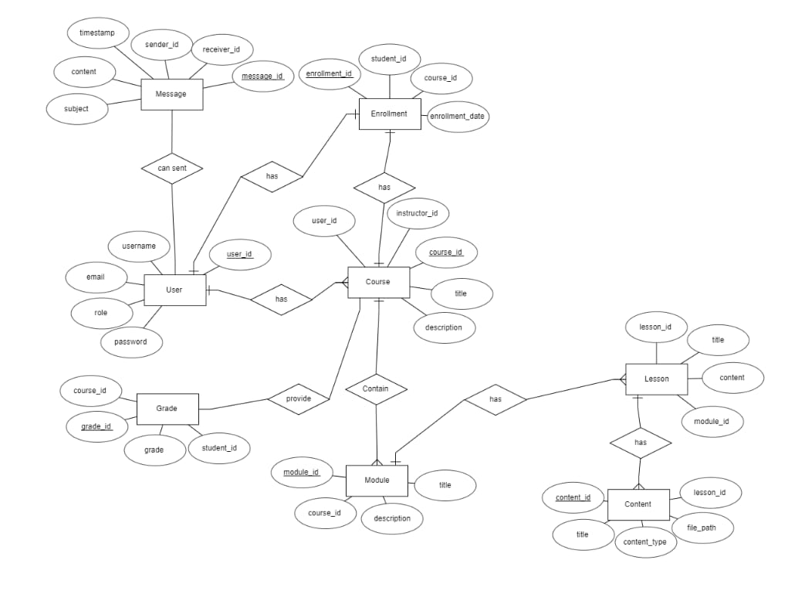
ER Diagram

Slide 11
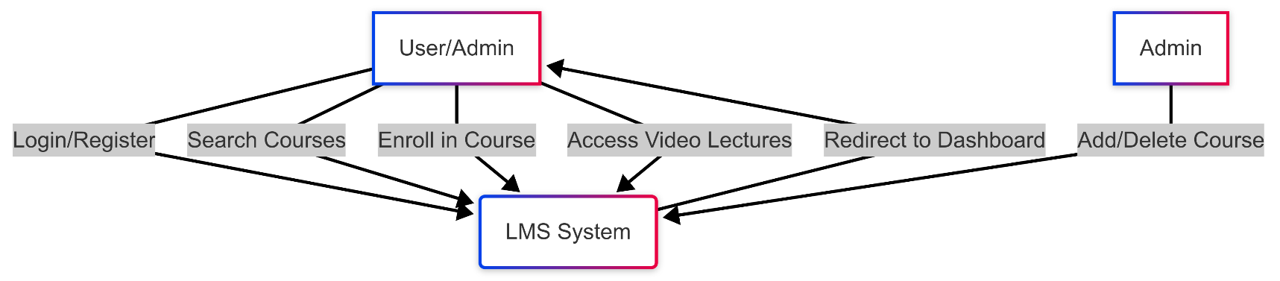
Data Flow Context Diagram

Slide 12
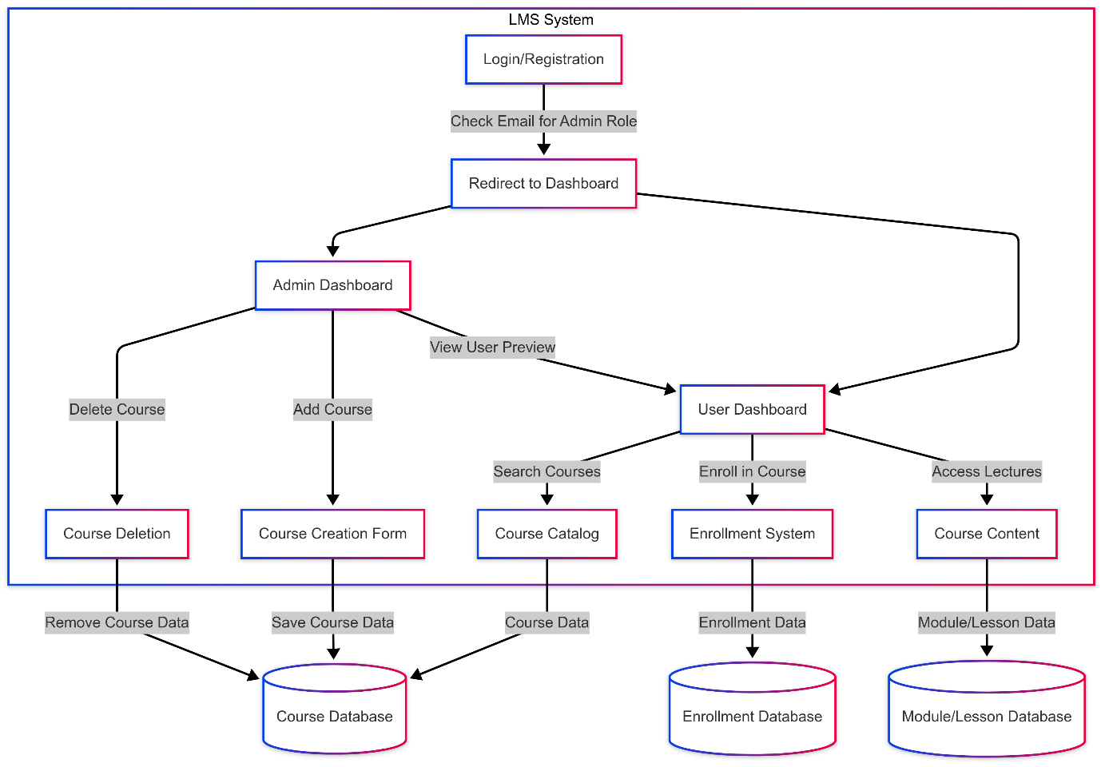

Slide 13
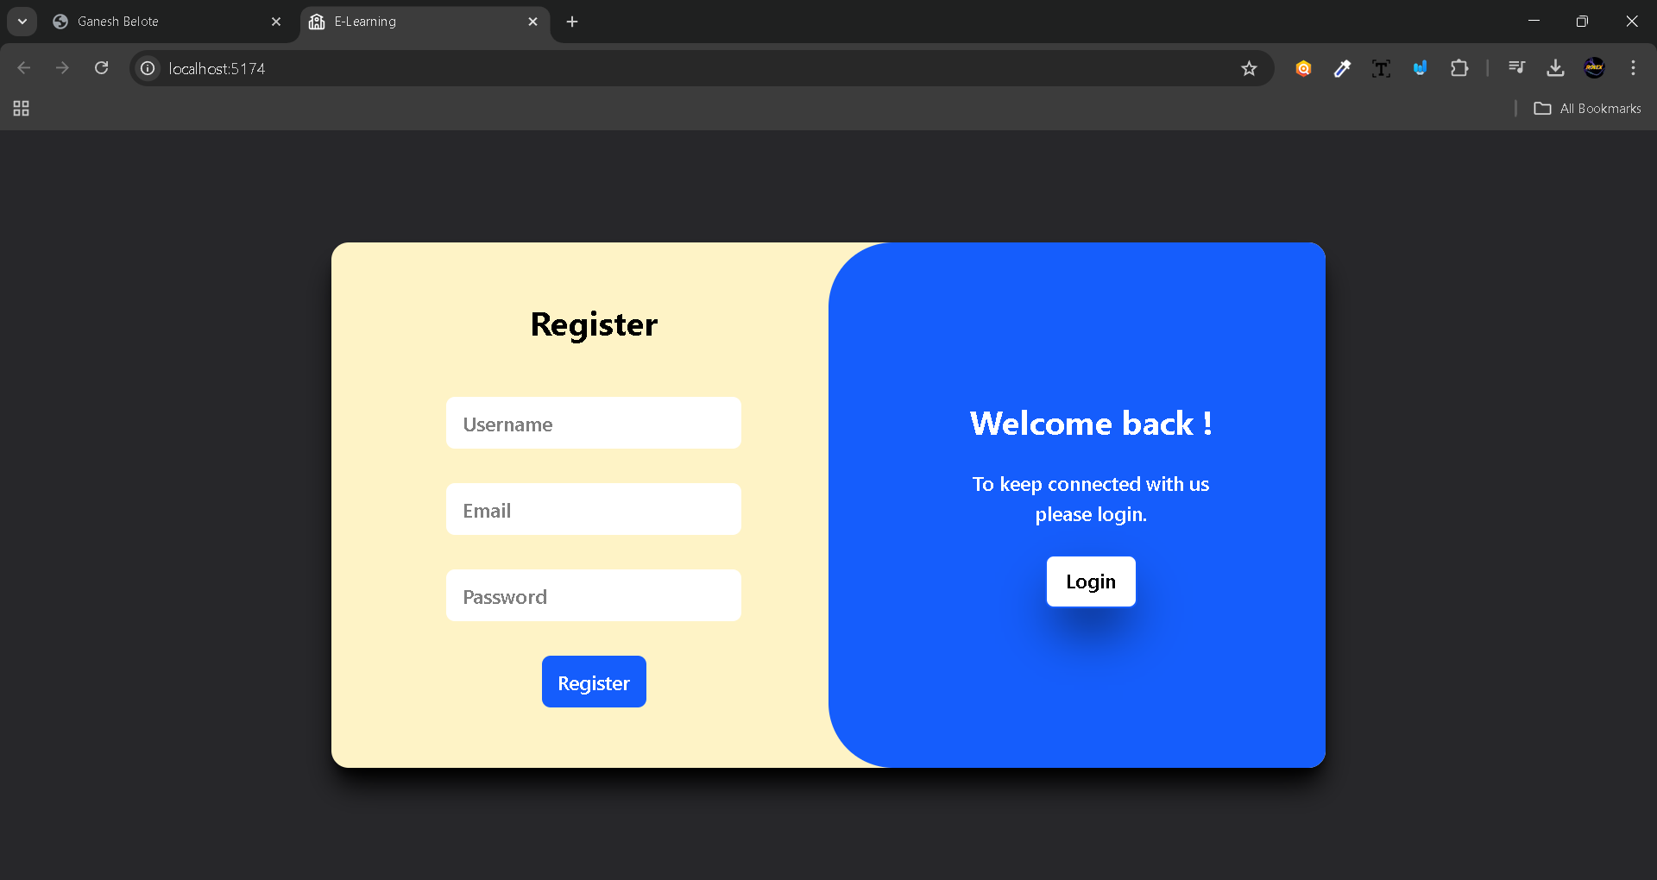
Input Screens

Slide 14
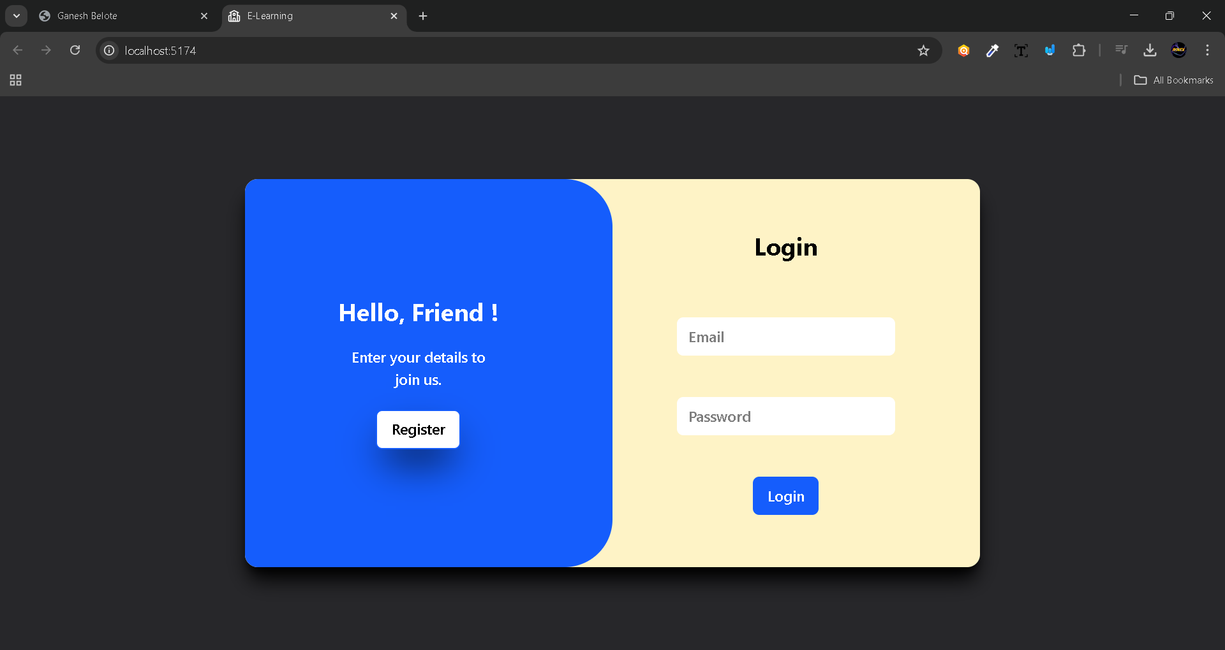

Slide 15
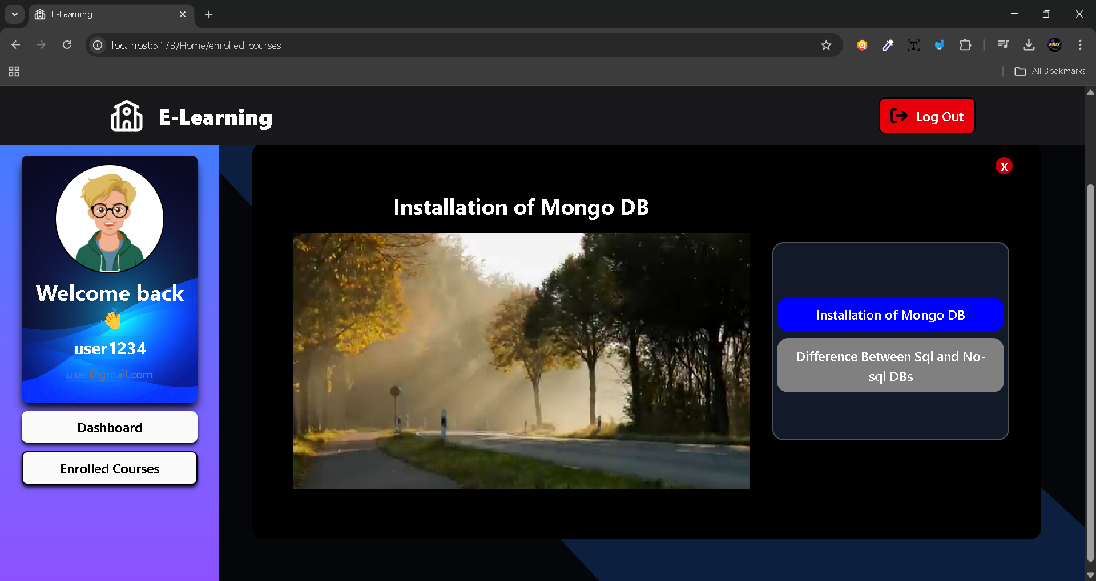

Slide 16
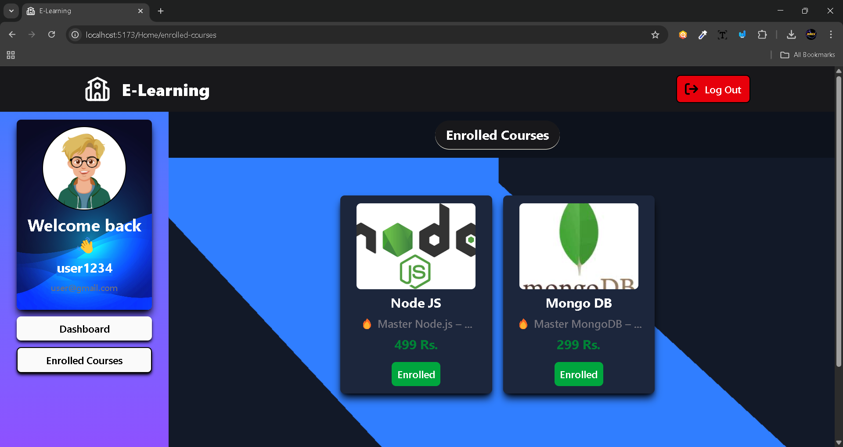

Slide 17
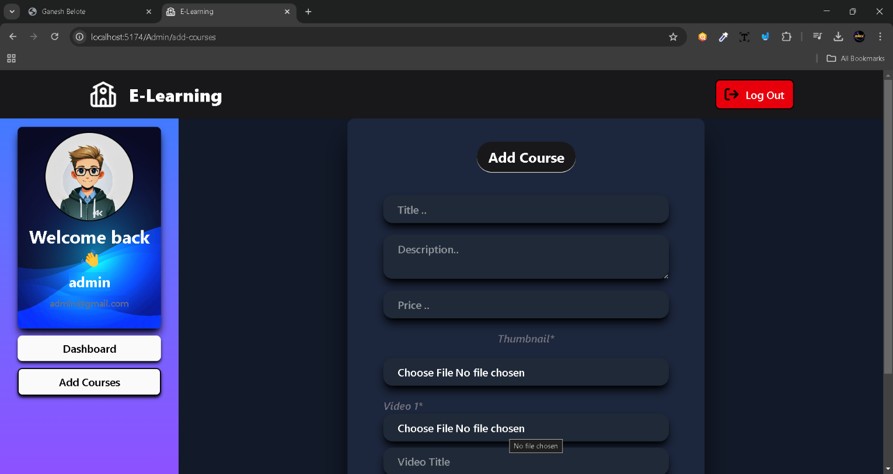

Slide 18
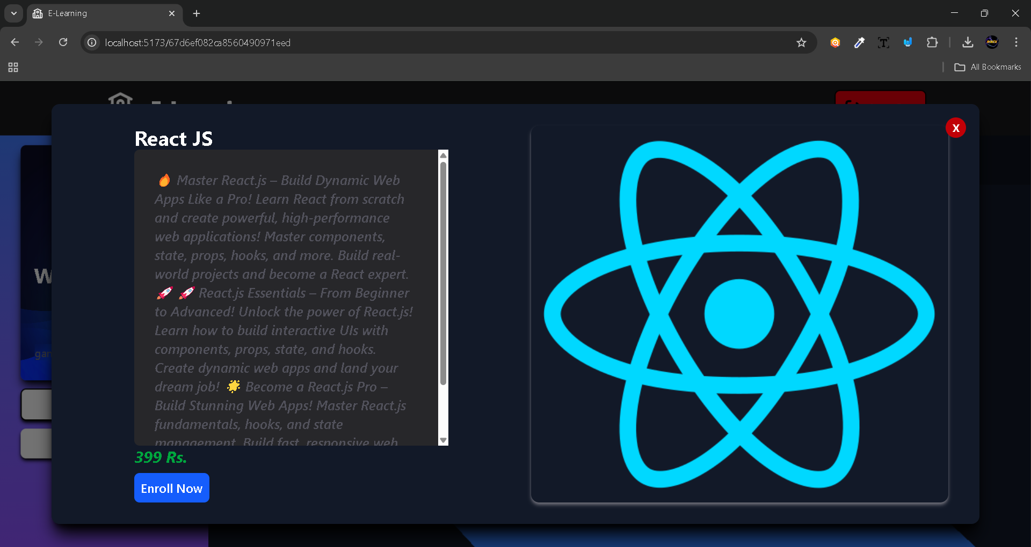

Slide 19
Conclusions
The successful implementation of a Learning Management System involves understanding its purpose and benefits, planning effectively, selecting the right platform, and providing adequate training. An LMS can significantly enhance the learning experience when these elements are integrated properly, leading to more effective and engaging educational outcomes.

Slide 20
Thank you!

